Slide 1
Computer Architecture and Assembly Language
Practical Session 11
Input &Output (I/O)

Slide 2
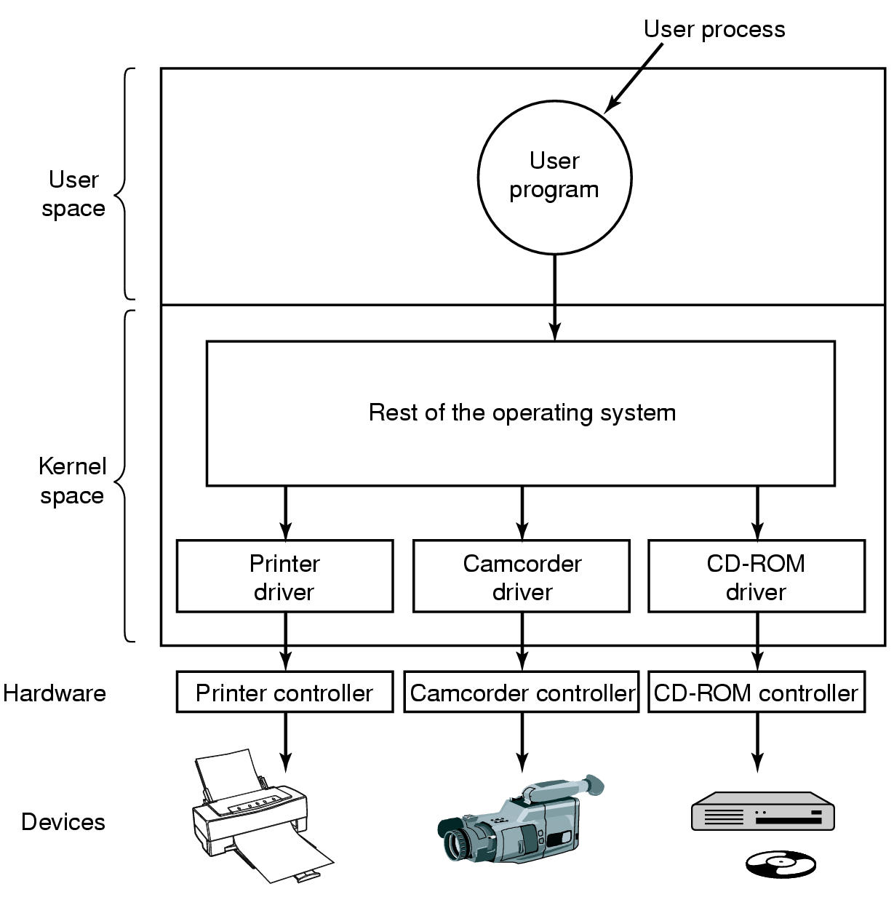
CPU-Memory-I/O Architecture
Input / Output (I/O) devices are used to interact with “outside world”
mouse, screen, disks, printer …
CPU
I/O module / I/O driver
Operating system
I/O controller
I/O device

Slide 3
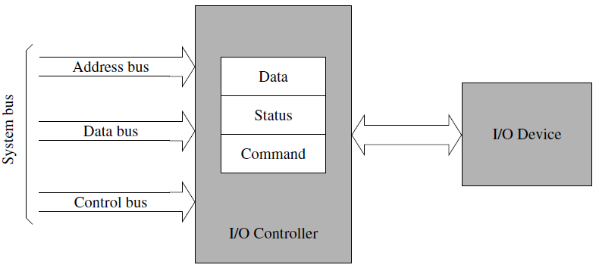
I/O Controller
Typically I/O Controller has 3 internal registers:
  Data register
  Status register
  Command register
Data in
Data out
Example: character output
Check status register of I/O controller
    e.g. busy, idle, offline
Put data into data in register
Put command into command register
    e.g. “send the character in data register to printer”

Slide 4
Programmed I/O
Software controls I/O operations
  slow ☹
  busy CPU wait ☹
  simple ☺
Interrupt-driven I/O
Device includes a signal to interrupt CPU (interrupt is produced by hardware)
When an interrupt occurs (and is accepted), a special routine executes to service the interrupt
  no CPU busy wait ☺
Direct memory access (DMA) I/O
DMA Controller
CPU transfer information to DMA controller (DMAC)
  location of data on device
  location of data in memory
  size of block to transfer
  direction of transfer
When device is ready, DMAC takes control of the system buses

Slide 5
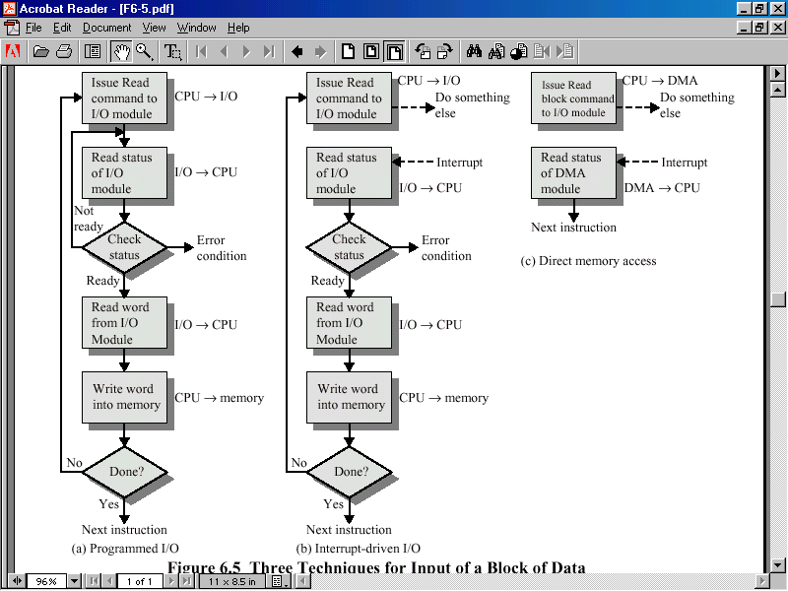
I/O controller
I/O controller
to DMA module
to DMA module
controller
controller
controller
controller

Slide 6
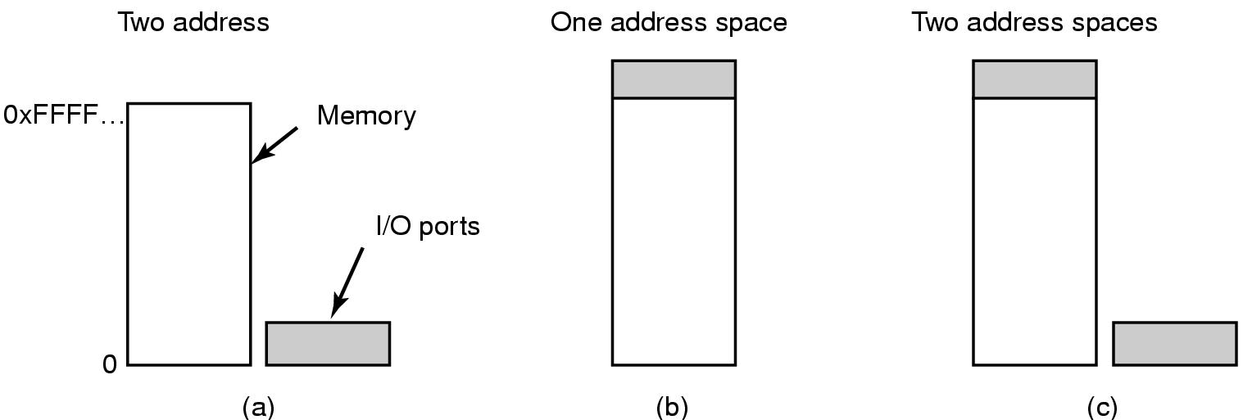
I/O Ports
I/O port is the address of I/O controller register
Two kinds of mapping:
Two address spaces
Isolated I/O
separate address spaces
special commands for I/O
in instruction is used to read data from I/O port:
  in register, port address (direct address)
  in register, DX (indirect address)
out instruction is used to write data to I/O port:
  out port address, register (direct address)
  out DX, register (indirect address)
register must be AL, AX, or EAX
x86 provides 64 KB of isolated I/O address space
I/O ports is not physical memory, it is virtual mapping of I/O controllers’ registers and to their addresses
I/O ports mapping table
address | I/O controller
0x60 | Screen device
… | …
Example:
RAM
data out register
mov byte [0x60], ‘a’
‘a’
0x60
I/O controller
mov AL, ‘a’
out 0x60, AL
‘a’
0x60

Slide 7
I/O Ports
I/O port is the address of I/O controller register
Two kinds of mapping:
Memory mapped I/O
no special commands for I/O
use regular memory read/write commands
Example:
I/O ports mapping table
mov byte [0x60], ‘a’
address | I/O controller
0x60 | Screen device
… | …
mov byte [0x80], ‘b’
RAM
Screen device I/O controller
data out register
0x60
‘a’
0x60
‘b’
0x80

Slide 8
Example – How to Write a Simple Keyboard Driver
Use PA input port register at address 60h
  PA7 = 0 if a key is pressed
  PA7 = 1 if a key is released
  PA0–PA6 = key scan code
Use busy wait loop
  wait until a key is pressed (i.e. until PA7 = 0)
  read scan code of the key
  wait until a key is released (i.e. until PA7 = 1)
Pressing ESC key terminates the program
PA7 | PA6 | PA5 | PA4 | PA3 | PA2 | PA1 | PA0

Slide 9
Example – How to Write a Simple Keyboard Driver
section .data
ESC_KEY EQU 0x1B ; ASCII code for ESC key
KB_DATA EQU 0x60 ; port PA
section .text
global _start
_start:
key_down_loop: ; loop until a key is pressed i.e., until PA7 = 0
in AL, KB_DATA ; read keyboard status & scan code
test AL, 0x80 ; PA7 = 0? (0x80=10000000_{b})
jnz key_down_loop ; if not, loop back
and AL,0x7F ; (0x7F=01111111_{b}) – isolate scan code
..translate scan code to ASCII code in AL..
cmp AL, ESC_KEY ; ESC key - terminate program
je done
key_up_loop: ; loop until a key is released i.e., until PA7 = 1
in AL, KB_DATA ; read keyboard status & scan code
test AL, 0x80 ; PA7 = 1? (0x80=10000000_{b})
jz key_up_loop ; if not, loop back (busy wait)
jmp key_down_loop
done:
..exit program..
TEST instruction performs a bitwise AND on two operands. The flags SF, ZF, PF are modified while the result of AND is discarded.
Notes:
test AL, 80H ; PA7 = 0?
80H is the most significant bit, which indicates if ‘makash’ is up or down

